Slide 1
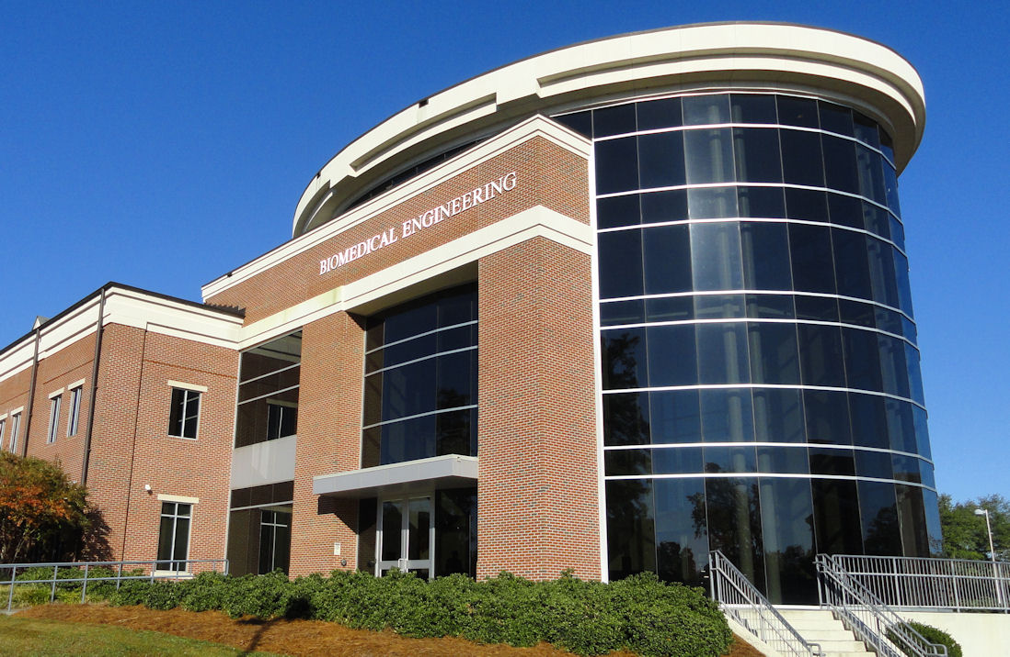
General Safety and Building Access for BME

Slide 2


Access to Building
Normal Building Hours: 7:30 AM – 5:30 PM
You must have authorization for other hours
Access requires electronic card from tech express and, in some cases, a key/FOB (requires a $20 NONREFUNDABLE deposit).
*****This is currently being updated to the Tech ID system!!!!

Slide 3

Access to Building
No one allowed without an access card or key into the building or controlled access area.
After hours requires someone in the building with you.
After Hours access requires permission from an Administrator/Safety officer and your Professor.
Never Open Doors for Other students who do not have proper Access.

Slide 4
Clothing in the Laboratory
Wear proper clothing: PPE- Personal Protective Equipment/ Classroom is OK☺
No shorts
Shoes must have covered tops (no flip-flops)
Long Hair tied back if necessary
Gloves and protective Clothing when necessary
Safety Goggles
Face Mask and/or Respirator for hazardous materials
Chemically Resistant Gloves for hazardous materials
Chemical Apron for hazardous materials

Slide 5

Building Alarm
Leave the building immediately:
Fire
Chemical Spill (producing hazardous gas)
Ventilation Failure
Police and/or fire personnel will arrive soon. Give them your full cooperation.

Slide 6
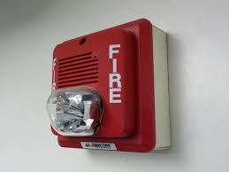
Fire Safety
During an emergency such as a fire or chemical spill:
a. The most important consideration is your personal safety.
b. Help others if you are able.
c. Do not attempt to save an experiment unless you can do so without endangering you or others.

Slide 7

Know where the exits are located!
a. During an emergency the elevator will not work.
b. If you are on an upper floor use the stairs.
c. Once on the ground level leave by the nearest safe exit.
d. If there is smoke or a strange smell between you and the exit, find another exit!
e. Go to Spirit Park and wait for further instructions.

Slide 8

Do not attempt to put out the fire.
a. The sprinkler system should activate and suppress the fire.
b. Use the fire extinguisher only if you are completely blocked from getting out of the building.
c. Make sure that the extinguisher is correct for type of fire.
d. Aim the extinguisher at the base of the fire.

Slide 9
Safety Equipment
Know the location and use of the following:

Slide 10
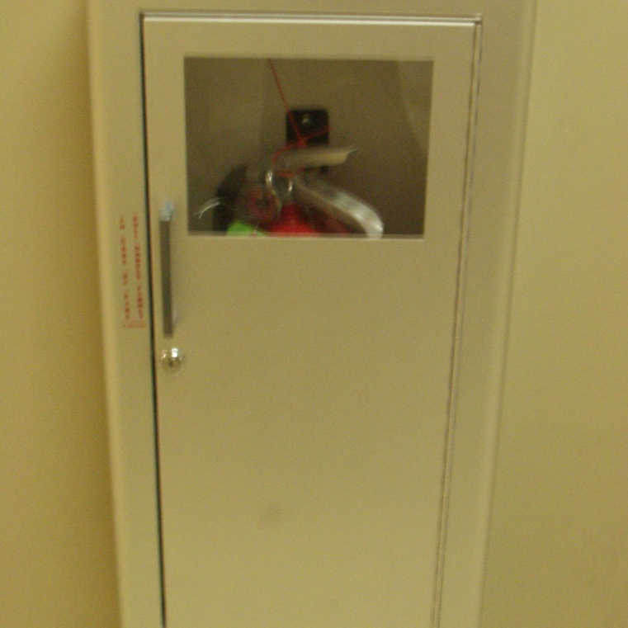
Fire Extinguisher
-Fire Extinguishers
Located in Hallways

Slide 11
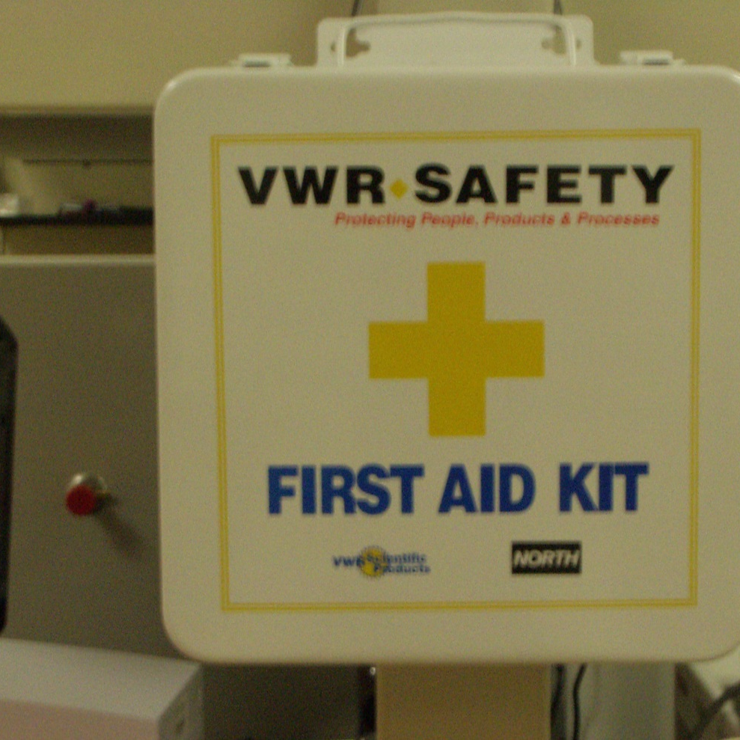
First Aid Kit
Located in each lab

Slide 12
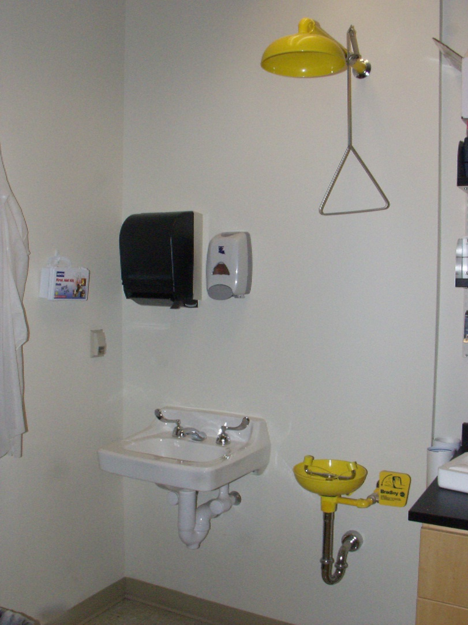
Safety Showers And Eye Wash Stations
Located in, or near, each lab
If exposed to a potentially dangerous chemical, the affected area should be washed a minimum of 15 minutes.
Flush eyes as long as necessary or until help arrives.

Slide 13
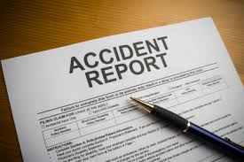
Safety Equipment
Report Accidents
Tell your Lab Director Immediately
You must fill out an accident report.
Forms are in the building offices.

Slide 14
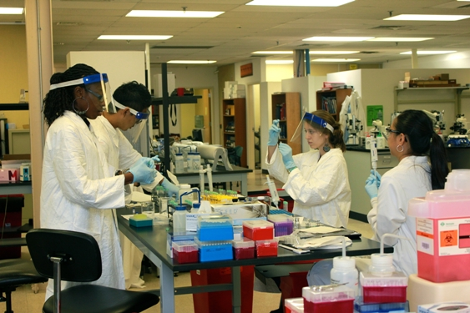
Equipment
Never use an instrument you are not trained to use.
Never train someone to use an instrument unless someone in authority gives you permission to provide the training.

Slide 15
Problems or Unsafe Conditions
If you see a problem, report it to the office or someone with authority.
If the problem is after hours, call the Tech Police (257-4018).
Failure to report and or disregard of the safety rules could result in loss of building privileges.

Slide 16

Safe Use of Chemicals
Never use chemicals with which you are not familiar.
Always label chemicals whether they are stored or currently being used in the laboratory. Label should include Owners Name, Chemical name, Date.
Where appropriate Clothing/safety gear when handling.

Slide 17
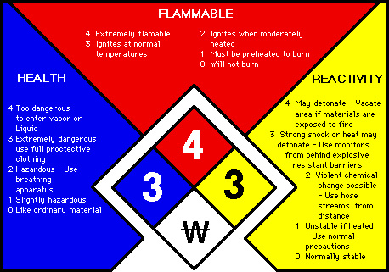
Have MSDS information for every chemical you use. MSDSs are a widely used system for cataloging information on chemicals, chemical compounds, and chemical mixtures. MSDS information may include instructions for the safe use and potential hazards associated with a particular material or product. MSDS database can be located at www.sigmaaldrich.com/safety-center.html
Material Safety Data Sheets

Slide 18
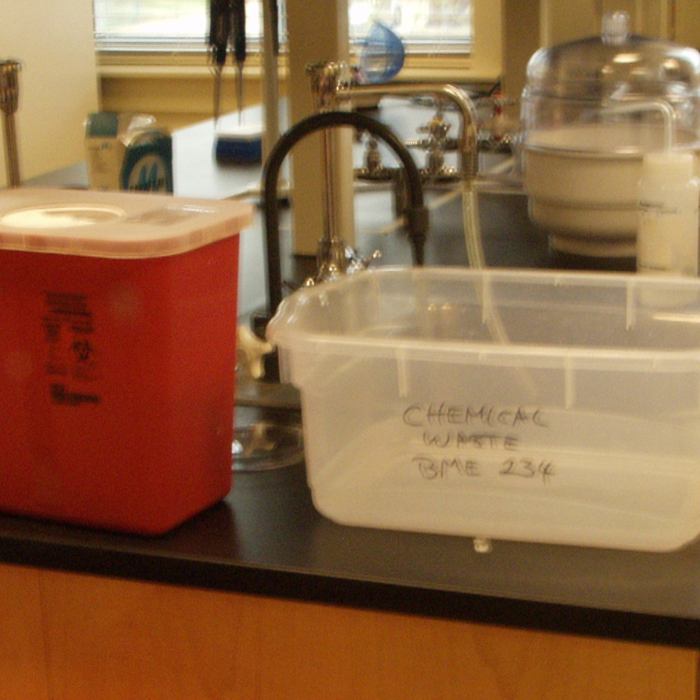
Always store and dispose of chemicals properly. Look for proper Disposal Labels. Never throw Biohazard/Chemical materials in the regular Trash!
Chemical Safety
Report spills of hazardous chemicals and make sure they are properly cleaned.

Slide 19
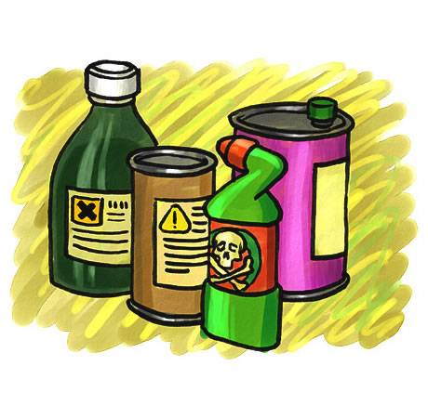
Chemical Disposal
Containers with Chemical waste that need to be picked up by Environmental Services. Email Me for pick up!
All items must be labeled and properly packaged for pickup.
Be sure to ask or know what chemicals are safe to store together here.
Extra Chemicals and large items are stored and

Slide 20
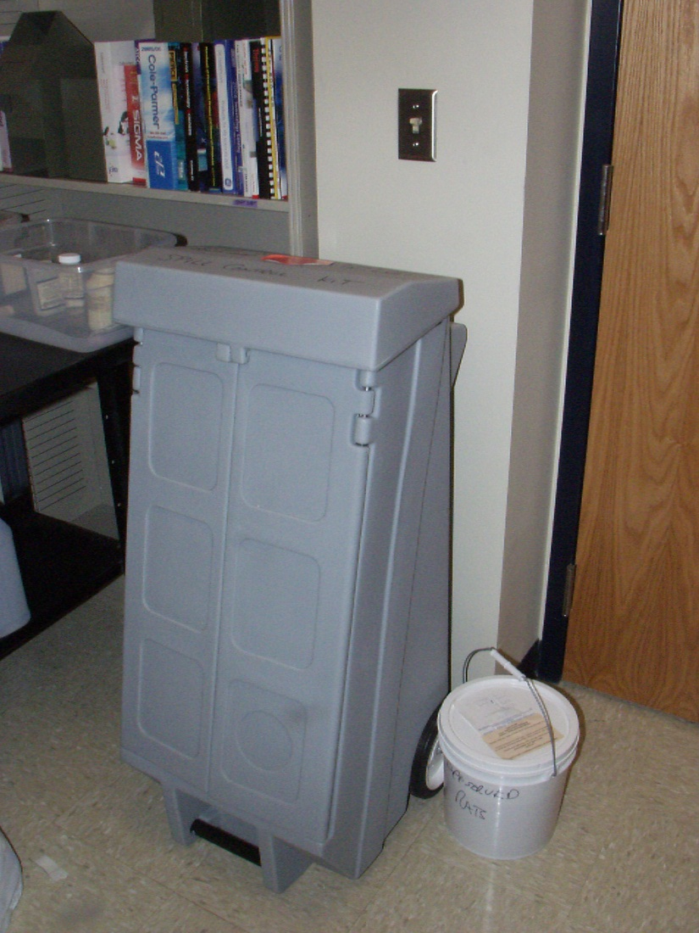
Know the location of the chemical spill equipment. Check the MSDS Sheets for information regarding proper cleanup procedures. The spill kit is on the Second floor Room #237. Some spill clean up material is also available in animal care. Small/ non hazardous spills can be cleaned according to MSDS with Lab cleanup materials.

Slide 21
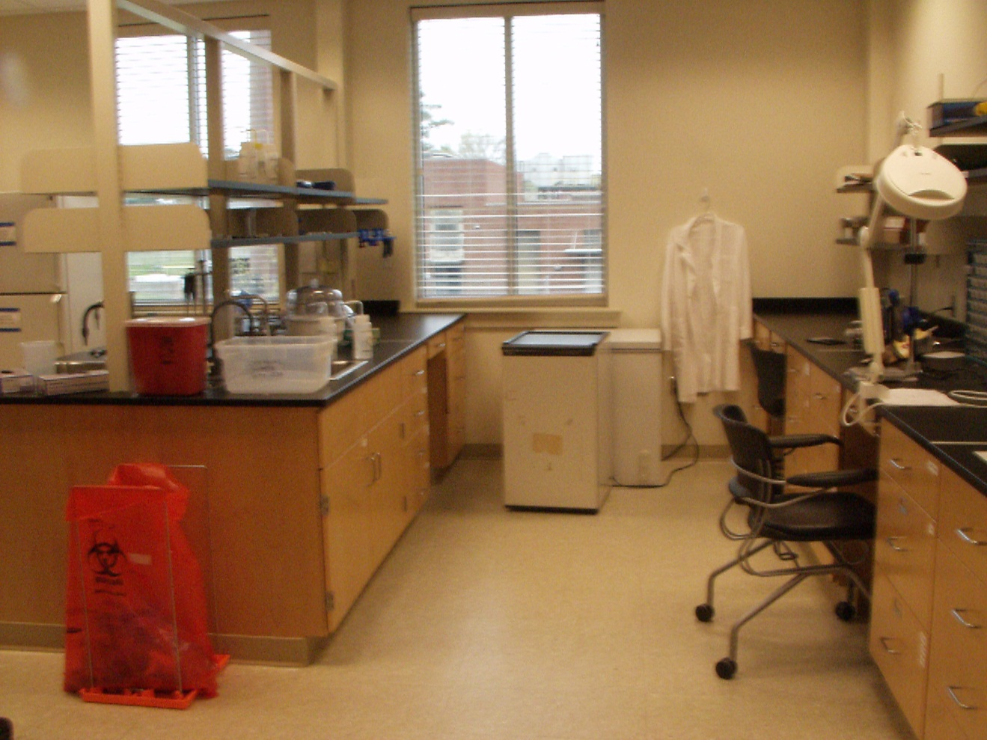
Safety in the laboratory is a shared responsibility between both the student and Professor! Keep the laboratories clean and orderly. Periodic Lab inspections will be conducted. -Do not leave experiments running unattended that may cause harm to others. No Food or Drink in the lab!
Common areas.
Individual labs.

Slide 22
General Biological Safety Information

Slide 23


Institutional Review Boards
Human Subjects – Human Use Committee
Biosafety and Radionuclide Institutional Review Committee (BRIRC)
Institutional Animal Care and Use Committee (IACUC)
Louisiana Tech Campus wide Policies
All Groups help you to be safe and follow all federal guidelines.

Slide 24
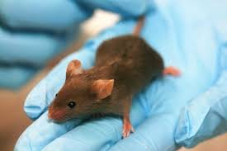
Laboratory Animals
Regulations are enforced by the IACUC (Institutional Animal Care and Use Committee)
Regulations function to:
Promote better research
Protect the animals
Protect the researcher
Adhere to all Federal Laws
Which include USDA and OlAW (Office of Laboratory Animal Welfare)

Slide 25

Biohazards: BRIRC Committee
1. Purchase, storage, use, and disposal of recombinant DNA, including transgenic animals or plants; 2. Purchase, storage, use, and disposal of microorganisms (bacteria, viruses, parasites or fungi) that are potentially infectious to humans, other animals, or plants; 3. Purchase, storage, use, and disposal of biological toxins; 4. Purchase, storage, use, and disposal of human and other mammalian tissue, including blood and other body fluids; 5. Purchase, use, storage, and disposal of radionuclides 6. Purchase, use, storage, and disposal of pesticides or herbicides. 7. Purchase, storage, use and disposal of euthanizing agents 8. Purchase, storage, production and/or the use, and disposal of nanoparticles; 9. Field release of plant pest or genetically modified organisms.

Slide 26


Biohazards (Cont’d)
Some laboratory conditions may pose a danger to reproductive health. For example, ionizing radiation and mutagenic chemicals may cause damage to gametes or to the developing embryo or fetus.
It is imperative to know what you are working with so not to hurt yourselves or others.

Slide 27
Biohazard Protective Strategies
Always ask Permission from regulators. On Campus for Example the BRICR Committee, approval is required for Biohazardous Chemicals. Other Committees may be necessary for Review. (IACUC, IRB, Export Control)
Clothing(PPE-Personal Protective Equipment)
Laboratory coat or hazard suit
Gloves
Masks
Eye Protection
Plan ahead – put it on paper. Help prevent Accents!
When possible, substitute a less hazardous chemical
Use the smallest quantity of material necessary
Anticipate the possible consequences of the work you do

Slide 28
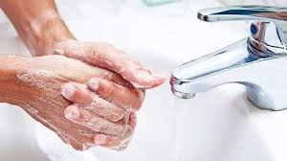
Biohazards (Cont’d)
Hygiene
Always wash your hands after working and before leaving the lab.
Disinfect and clean up your work area.

Slide 29
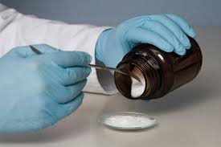
Gloves
Latex Gloves should never be re-used!
Inspect Gloves for holes/damage
Wear gloves of a material known to be resistant to permeation by the substances in use
Remove gloves before handling objects such as doorknobs, telephones, pens, and computer keyboards/ Do not walk down hallways or around campus with Dirty Gloves on both Hands!!!
Replace gloves periodically, depending on the frequency of use
Only dispose of Gloves in the Biohazard or Chemical waste labeled BAGS! NOT in the regular Trash.

Slide 30
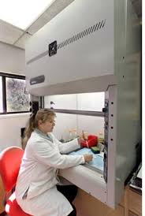
Types of Hoods and Hood Safety:

Slide 31
Clean Benches and Fume Hoods are Not Biological Safety Cabinets
Biological safety cabinets (BSC) must not be mistaken with fume hoods and clean benches.
BME contains BSL2 level cabinets, but currently will ONLY ALLOW BSL-1 Organisms in BME!!!
BSC is not a substitute for a fume hood and should never be used with large concentrations of hazardous chemicals.
Fume hoods are used to protect personnel from exposure to chemical hazards and, in general, are not suitable for work involving biohazards.
Clean benches protect research products from contamination but do not afford protection to the user. Thus, clean benches should not be used when working with potentially infectious materials, chemical hazards or radioactivity.

Slide 32
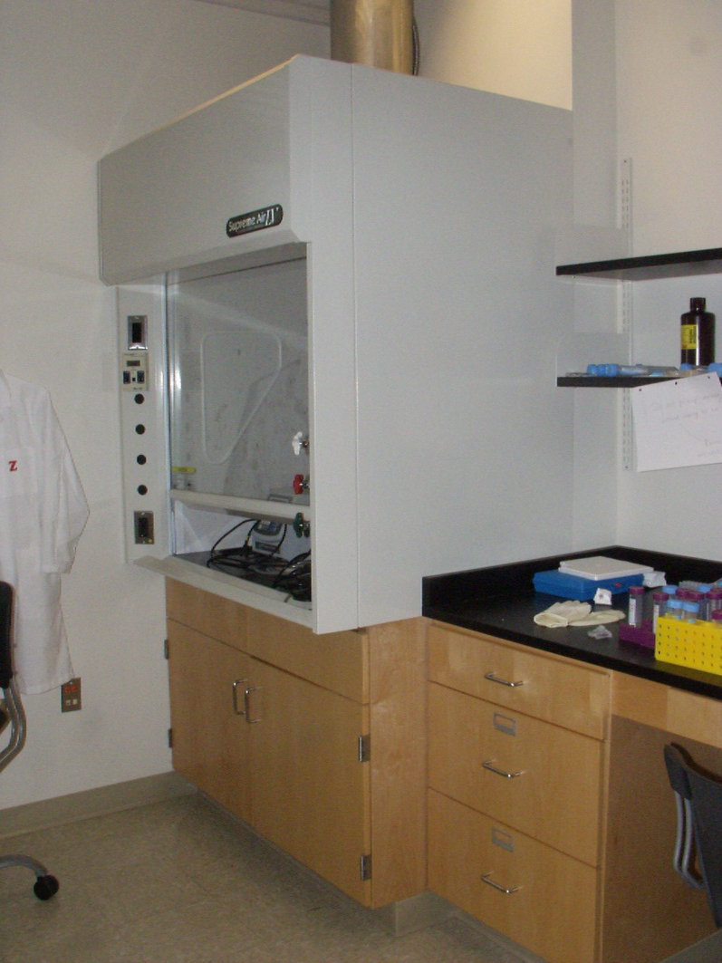
Chemical Safety Hood – Vented directly Outside -Minimize the number of objects stored in the hood – keep at least 50% of the working surface clear, if possible. -Always place containers and equipment at least six inches into the hood from the face. -Place containers and equipment toward the sides of the hood to reduce obstruction of the exhaust slots.

Slide 33
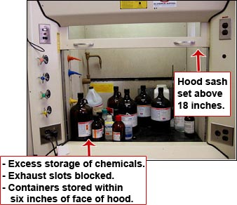
Example of a fume hood that has been set up incorrectly.

Slide 34
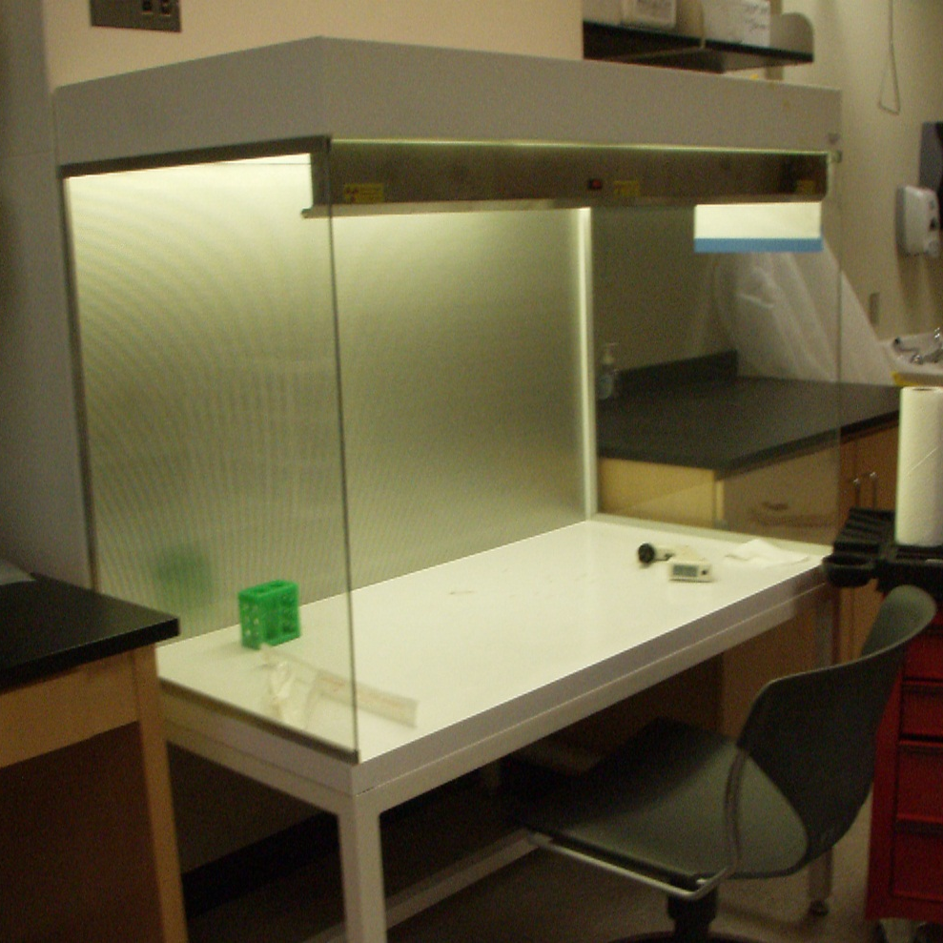
No Caustic Chemicals that would Damage the hood or Harm you! Only those items that will not cause harm to yourself and the environment. *Laminar flow cabinets may have a UV- lamp to sterilize the interior and contents when not in use. Be sure to limit exposure whenever possible to this light, and do not stare directly into the UV light.
Tissue Culture Cabinet (Laminar Flow Hood)

Slide 35
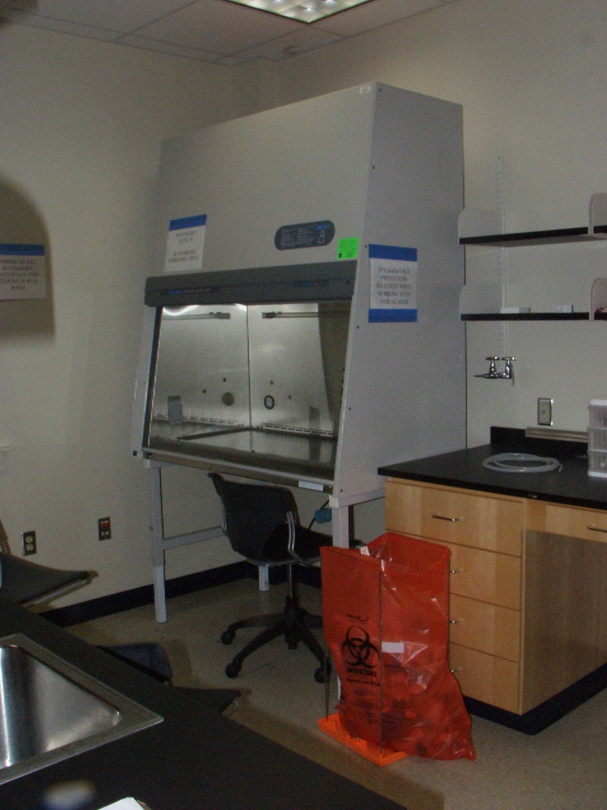
Biological Safety Cabinet –Class II Protects you from Biohazards. Do not use any Caustic Chemicals that would damage the hood or harm you! No Alcohol or Flames in the cabinets!

Slide 36
Waste Disposal

Slide 37
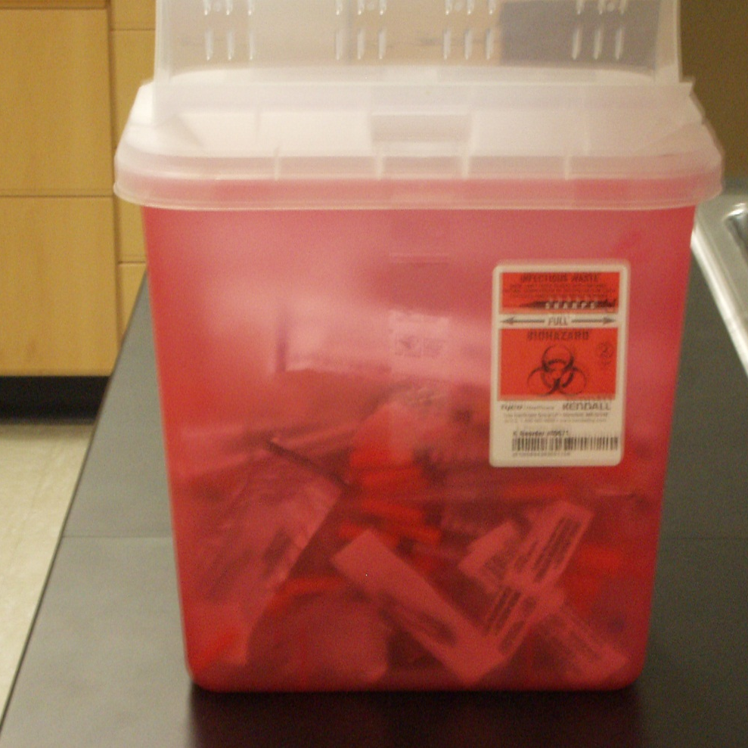
Syringes, needles, Scalpels, Razor Blades small broken Glass tubes, small glass pieces(slides) with biohazard Material.
Sharp Containers

Slide 38
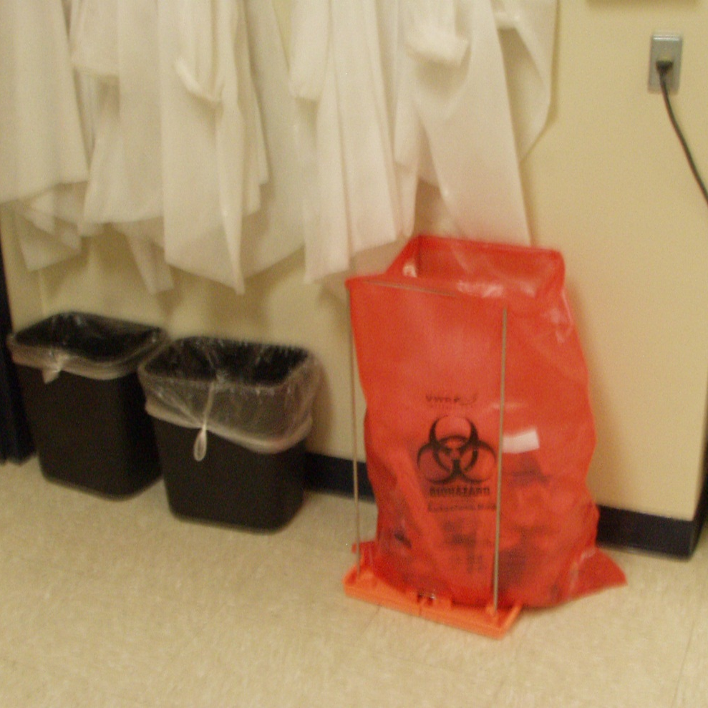

Biohazard and Chemical Bags DO not put Biohazards in the regular unlabeled Trash! Do not put Trash in the biohazard bags. Biohazards include Gloves used with animals or tissue culture and biologically contaminated material. Do not put packing boxes/bottles in these Bags! ** CHEMICAL WASTE BLACK Bags Located in Boxes are for Chemical Waste-including Gloves.

Slide 39
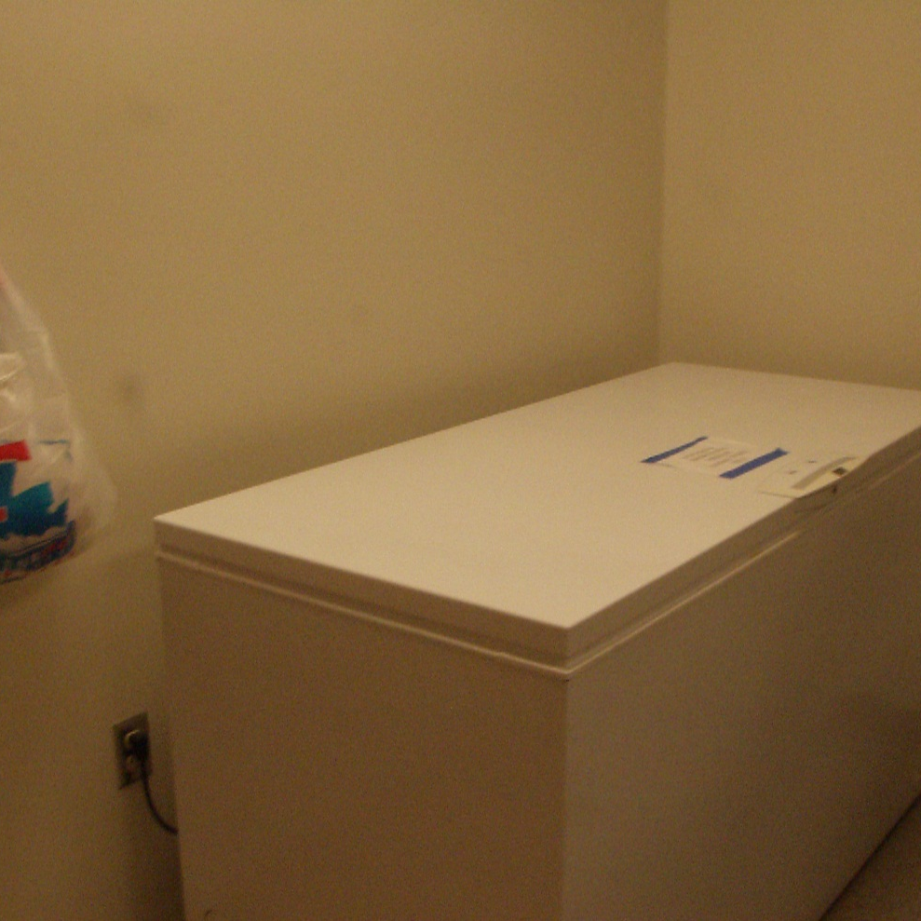
Animal Disposal
All Deceased Research animals must be kept in the appropriate labeled Freezer in Animal Care.
They can be placed in a small bag or Glove for disposal.

Slide 40
Before You start Summary:
1.Understand every part of the equipment before starting the experiment.
2. Think carefully before you operate the equipment.
3. Check Material Safety Data Sheets (MSDS) for all chemicals involved in the experiment.
4. Follow instructions and use info posted by the course or your PI .
5. Mechanical pipetting devices must be used; pipetting by mouth is not allowed.
6. Be aware that floors are slippery when wet and should be kept as dry as possible 7. Do not play around.
8. No food or drink in the lab. If needed, go to the hallway or designated area.
9. Pick up all trash and other materials and dispose of properly.
10. Wash hands before leaving the lab.
11. Remember the basic rules for chemicals:
◦ Don’t get them on your skin;
◦Don’t breathe the fumes;
◦Don’t eat them;
◦Don’t expose them to any combustion source.
12. Go through the checklist before starting a new experiment
13. Follow additional safety guidelines for individual experiments.

Slide 41
Checklist for New Experiment:
1.Locate the following safety equipment nearest to your work area:
◦First-aid kit
◦Fire extinguisher
◦Safety shower
◦Eyewash unit
◦Chemical spill kit
2.Locate the nearest exit
3.Check that the safety equipment, walkways, and circuit breaker panel are not obstructed.
4.Review Material Safety Data Sheets (MSDS) for chemicals involved in your experiment
5.Wear the Personal Protective Equipment (PPE) necessary for your experiment
6.Check that compressed gas cylinders are ◦Adequately secured
◦Capped or have regulators attached at all times
7.Plan ahead, label materials, tubes, supplies. No what you need before you start!

Slide 42
For your safety and the safety of others: KNOW WHAT YOU ARE DOING and WHEN IN DOUBT, DON’T DO IT! Ask for help- Don’t be afraid to ask questions! For BME Safety Issues/Questions Please Contact: Emily Born at eborn@latech.edu or 318-257-5206

